Slide 1
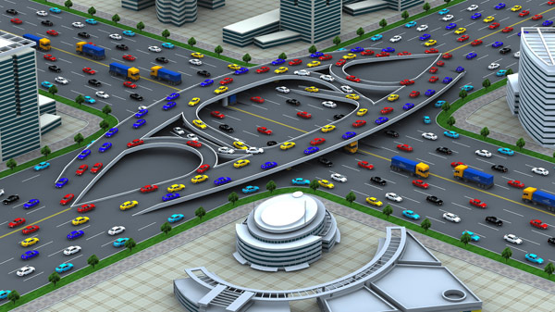
Traffic Engineering
University of Diyala
College of Engineering
Civil Engineering Department

Slide 2
Traffic Studies
Volume Studies
Speed Studies
Travel Time & Delay Studies
Parking Studies
Accidents Studies

Slide 3
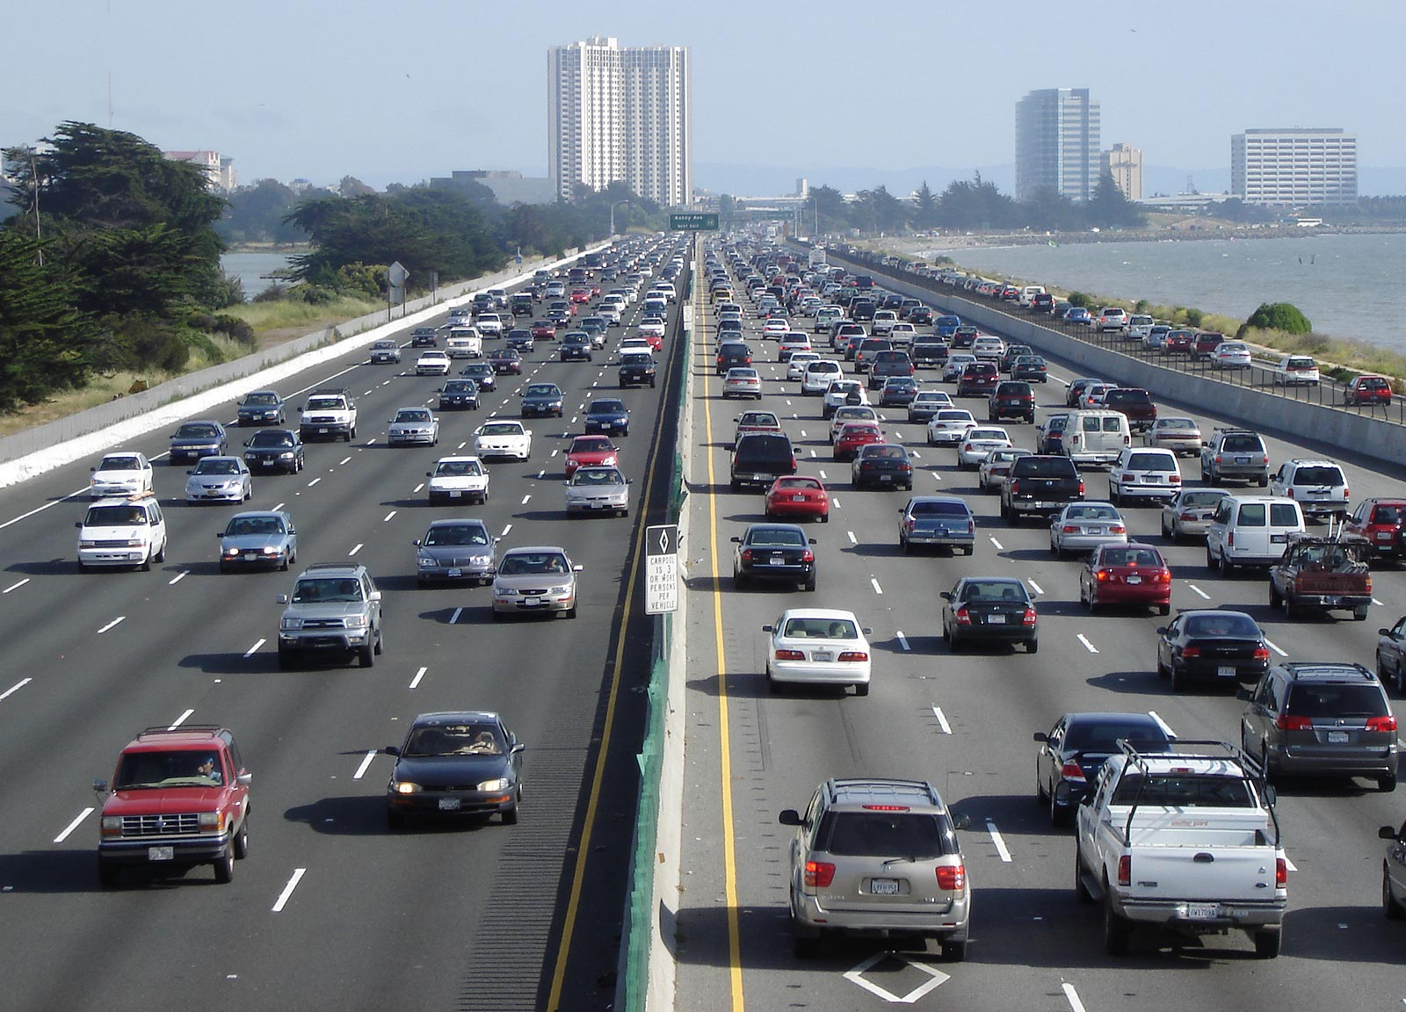
Traffic Volume Studies
The number of vehicles that pass appoint on a highway facility during a specified time period. 15 min. ------------- 1 year.

Slide 4
Purpose of Traffic Volume Studies
1. Obtain information for the seasonal and annual changes in the volume of vehicles.
2. Comparative economic sense when doing improving or modulating roads.
3. Design of intersections and choose the number of lanes.
4. Selection and design of pedestrian crossing areas.
5. Structural design of roads (tiling thickness and quality).

Slide 5
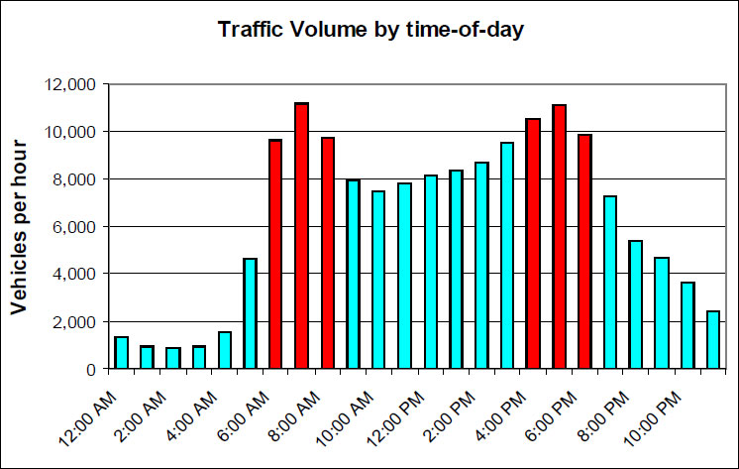
Traffic Fluctuation
Highway Capacity
Highway Congested

Slide 6
Traffic Fluctuation

Slide 7
Methods of Traffic Volume Counts
1- Manual Counting Method
Use filed personnel to count and classify traffic flowing past a fixed point.
Determine of vehicle classification, turning movements, direction of travel, pedestrian movements.
It used for periods of less than a day. Normal intervals for a manual count are 5, 10, or 15 minutes.

Slide 8
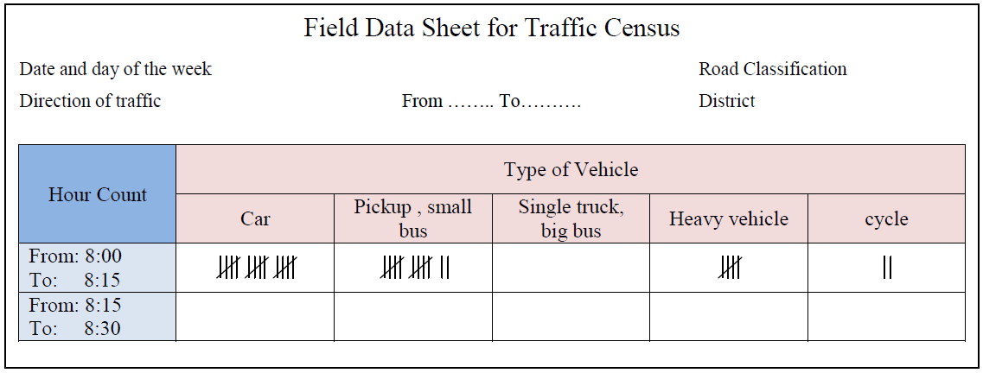
Methods of Traffic Volume Counts
1- Manual Counting Method
Multibank hand tally counter

Slide 9
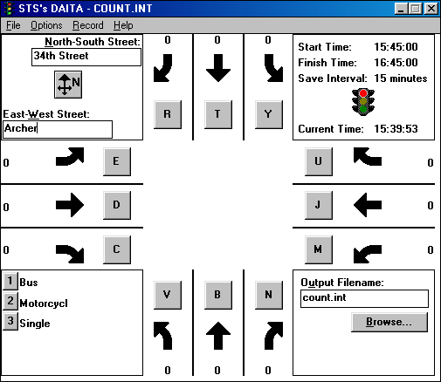
Methods of Traffic Volume Counts
1- Manual Counting Method

Slide 10
Methods of Traffic Volume Counts
2- Automatic Counting Method
Determine of vehicle hourly patterns, daily or seasonal variations and growth trends, or annual traffic estimates.
It are usually taken in 1-hour intervals for each 24-hour period. When the counts are recorded for each 24-hour time period, the peak flow period can be identified.

Slide 11
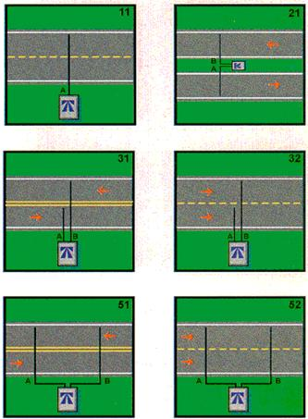
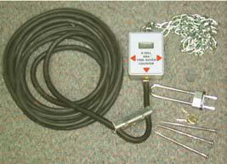
Methods of Traffic Volume Counts
1- Manual Counting Method
Detector (sensor): Pneumatic tube (road tube)
Recording Mechanism
- Counting register
- Printed output
- Electronic system

Slide 12

Types of Traffic Volume
1- Average Annual Daily Traffic (AADT):
The average (24-hr) volume at a given location over a full 365-days year
It is useful for:
a. Estimation of highway user revenues.
b. Traffic volume trends.
c. Development of hierarchical system of facilities.
2- Average Annual Weekday Traffic (AAWT):
The average (24-hr) volume occurring on weekdays over a full 365-days year
* The weekdays are 260, considering 5-days per week.

Slide 13


Types of Traffic Volume
3- Average Daily Traffic (ADT):
The average 24-hr volume at a given location over a defined time period less than one year
It is useful for:
a. Planning of highway activities
b. Measurement of current demand
c. Evaluation of existing traffic flow
4- Average Weekday Traffic (AWT):
The average 24-hr weekday volume at a given location over a defined time period less than one year

Slide 14
Example-1

Slide 15
Types of Traffic Volume
5- Peak Hour Volume (PHV):
Maximum number of vehicles that pass a point on a highway during a period of 60 consecutive minutes
It is useful for:
a. Functional classification of highways.
b. Design of geometric characteristics.
c. Capacity analysis.
d. Traffic operational plans.
e. Parking regulations.

Slide 16
Types of Traffic Volume
6- Design Hour Volume (DHV):
Is a representation of peak hour traffic, usually for the future, or horizon year, It is the 30th highest hourly volume of the year (abbreviated 30 HV). It is used for design purpose.
DHV = AADT * K
= ADT * K
Where (K) is the proportion of AADT occurring in the peak hour
K: (10 -17) % for two way.
K: (7 – 18)% for one way.
K: (0.12 _{(urban)} – 0.15 _{(rural road)}).
% of hourly volume
of ADT or AADT
70
15
10
5
20
30
40
50
60
200
Hightest hour of year

Slide 17
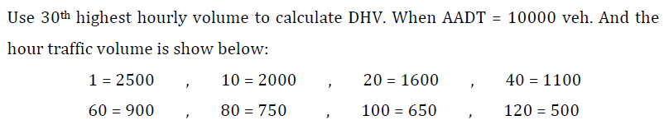
Example-2

Slide 18


Peak Hour Factor (PHF)
It is the ratio of the total hourly volume to the maximum 15min. rate of flow within the hour.
Where:
V: hourly volume (vph).
V₁₅: volume during the peak 15 min.

Slide 19
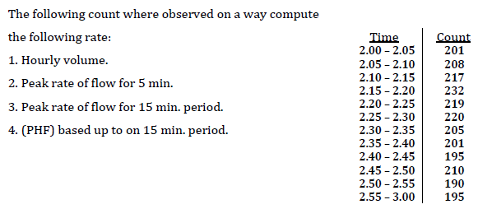
Example-3

Slide 20
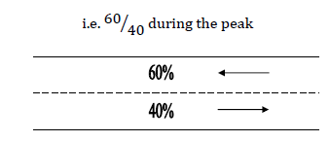
Directional Distribution (D):
Although traffic flows in each direction on a highway tend to be approximately the same over 24-hour period, during peak hours or on specific days there is likely to be higher percentage of traffic in one direction.

Slide 21
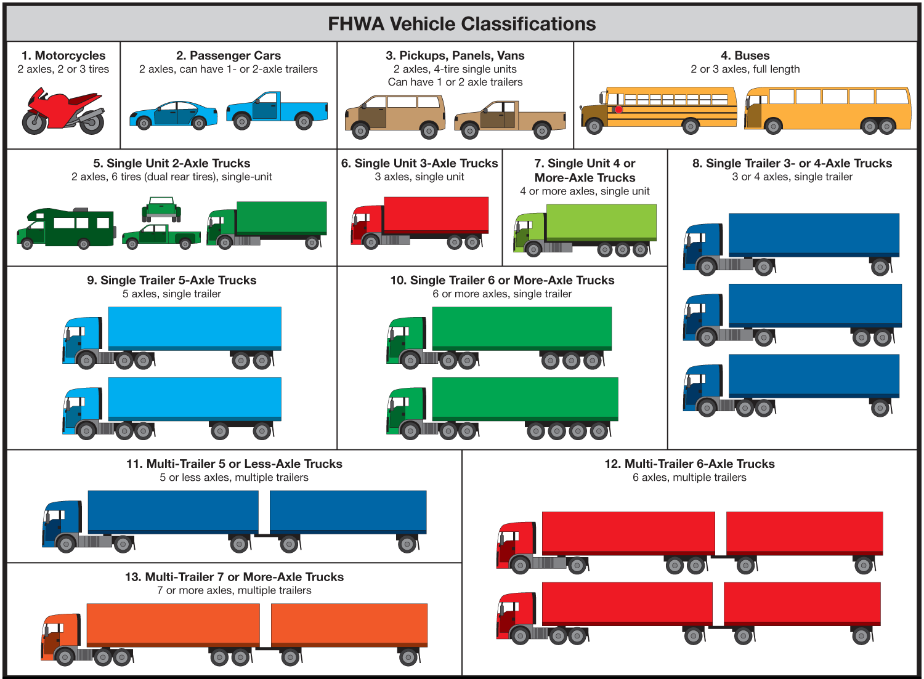
Traffic Composition:

Slide 22
Traffic Composition
Class of Vehicle | Terrain
 | Flat | Hilly | Mountains
Motorcycle, Bicycle | 0.5 | 0.5 | 0.5
Private car, Taxi | 1.00 | 1.00 | 1.00
Pick up, Van, Bus up to 24 passenger | 1.25 | 1.75 | 3.00
Single truck, Bus above 24 passenger | 2.00 | 3.00 | 6.00
Truck and trailer, Heavy vehicle | 3.00 | 5.00 | 10.00

Slide 23
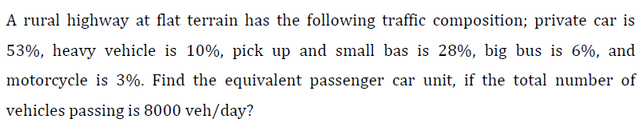
Example-4

Slide 24
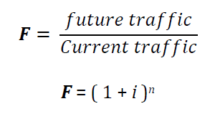
Traffic Forecast
The design of new highways or of improvements to existing highways is based on the future traffic.
A period of 15 to 20 years is widely used for design traffic.
F = Traffic forecast factor
i = Annual rate of traffic increase
= (% normal growth + % development traffic + % generated traffic)
n = Traffic analysis period

Slide 25
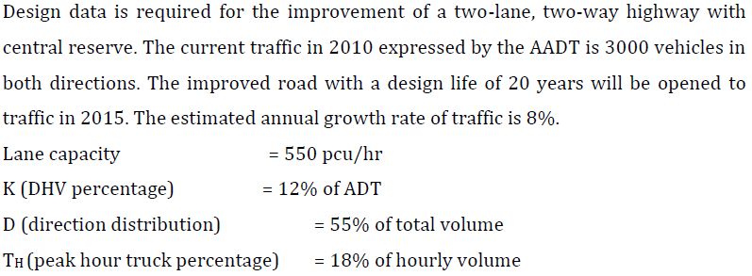
Example-5

Slide 26
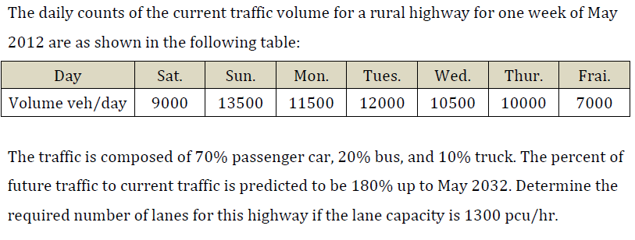
Example-6

Slide 27
Quiz
The following table show the results of current traffic counts for a rural highway at each 15 min. intervals during two hrs. Calculate:
Peak hour volume
Peak hour factor
Current and future design hour volume
If the design life is 25 years and construction time 6 years
Time | 7:00-7:15 | 7:15-7:30 | 7:30-7:45 | 7:45-8:00 | 8:00-8:15 | 8:15-8:30 | 8:30-8:45 | 8:45-9:00
Volume (veh.) | 100 | 200 | 700 | 800 | 600 | 300 | 100 | 50

Slide 28



Adjustment of Periodic Counts
Hourly expansion factors (HEF)
2.Daily expansion factors (DEF)
3.Monthly expansion factors (DEF)

Slide 29
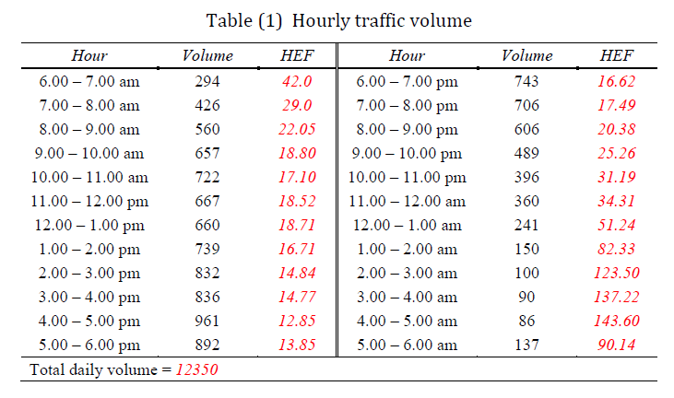
Example-7

Slide 30
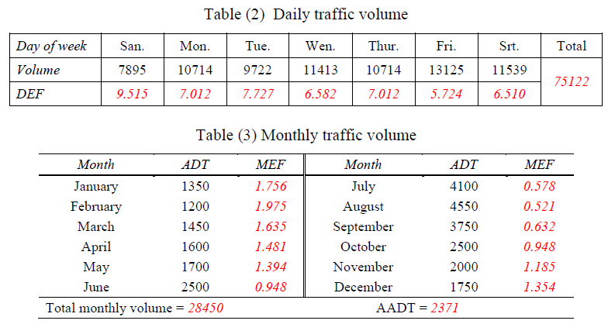
Example-7

Slide 31
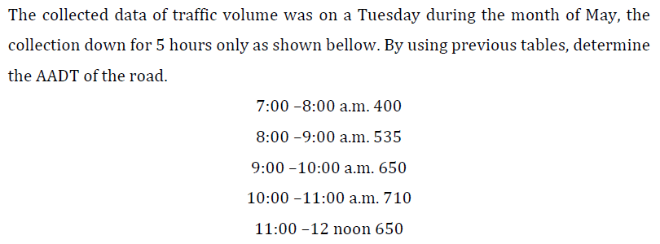
Example-8

Slide 32
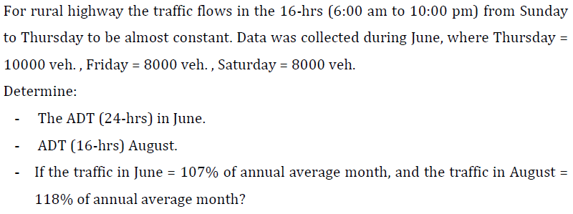
Example-9

Slide 33
H.W
For design of an urban road within a city. The counting of traffic was for two hours in a peak morning during Sunday in February 2014 in both directions, as shown below. The traffic components are 60% small car, 15% buses, and 25% heavy trucks. The design life of road is 15 years and expected to finish the road in 2016. If you know: the annual growth rate is 3%, the direction distribution is 40/60 %, the expansion factor of traffic are (Hourly: 36.1, 40.8 for first and second hour respectively, Daily: 6.1, Monthly: 0.8). Calculate the following:
Peak hour factor and design hour volume for the data.
No. of lanes required for the road, if the lane capacity is 700 pcu/hr
Time | 7:00-7:15 | 7:15-7:30 | 7:30-7:45 | 7:45-8:00 | 8:00-8:15 | 8:15-8:30 | 8:30-8:45 | 8:45-9:00
Volume (veh.) | 82 | 112 | 100 | 98 | 116 | 110 | 100 | 95

Slide 34


